Slide 1
Exploratory Data analysis Factory Day, August 2023
SSG Malagon & CPT Kuehnert

Slide 2
“…Often the most effective way to describe, explore, and summarize a set of numbers– even a very large set – is to look at pictures of those numbers.” - Edward Tufte, The Visual Display of Quantitative Information.

Slide 3
Agenda
Overview of Data Visualization (0930-1200)
What is EDA
Do's and Don'ts
Hands on with Titanic Dataset
Group EDA
Lunch (12-1300)
AI Tech Cohort 3 Capstone Culmination Presentations (1330-1600)

Slide 4
What is eda
Exploring a dataset to understand patterns, identify errors, and analyze data before making assumptions
Effectively communicating information, highlighting important features and trends
Visually representing quantitative and qualitative Information

Slide 5
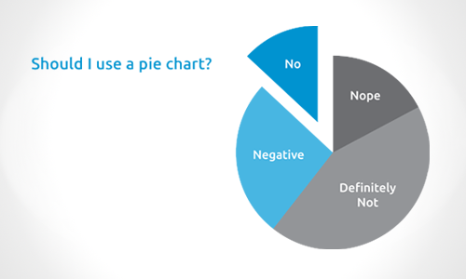
When do we use pie charts
https://evolytics.com/wp-content/uploads/2014/10/Should-I-use-a-pie-chart.png

Slide 6
When do we use visualizations
Inspire Action or Entertain
Aid in Decisionmaking
https://www.gapminder.org/fw/world-health-chart/
https://www.infoworld.com/article/3088166/why-how-to-lie-with-statistics-did-us-a-disservice.html
https://finviz.com/map.ashx
https://taskandpurpose.com/news/army-new-futuristic-ivas-goggles/
Understand data for modelling

Slide 7
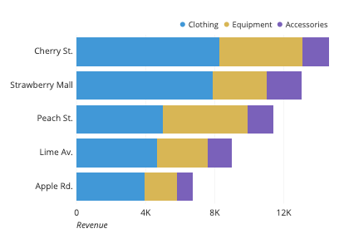
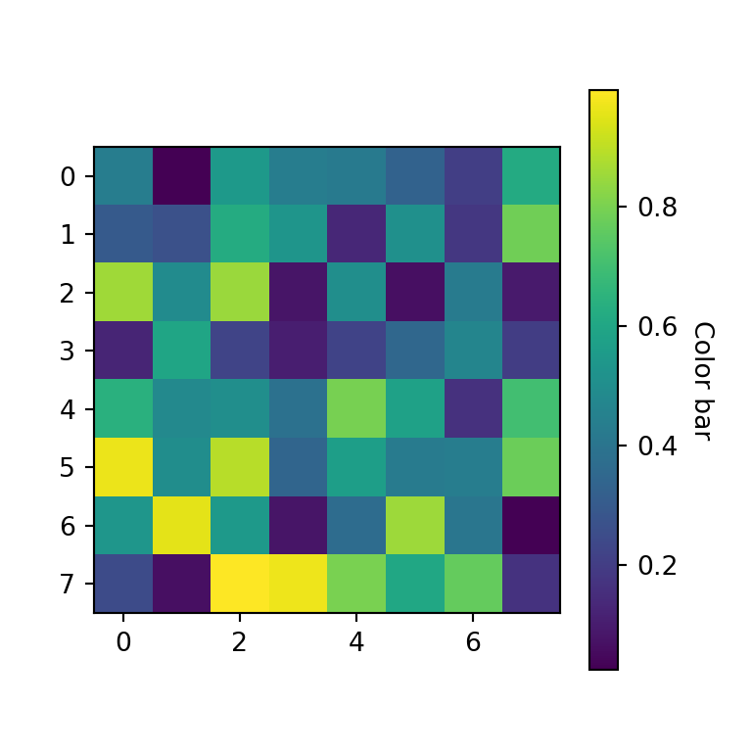
how do we use visualizations
Comparisons across a category
Bar chart, time series, dot plot
Relationship between variables
Correlations, heat maps
Scatterplots, box plots
Distributions of a variable
- Scatterplots, density plots

Slide 8
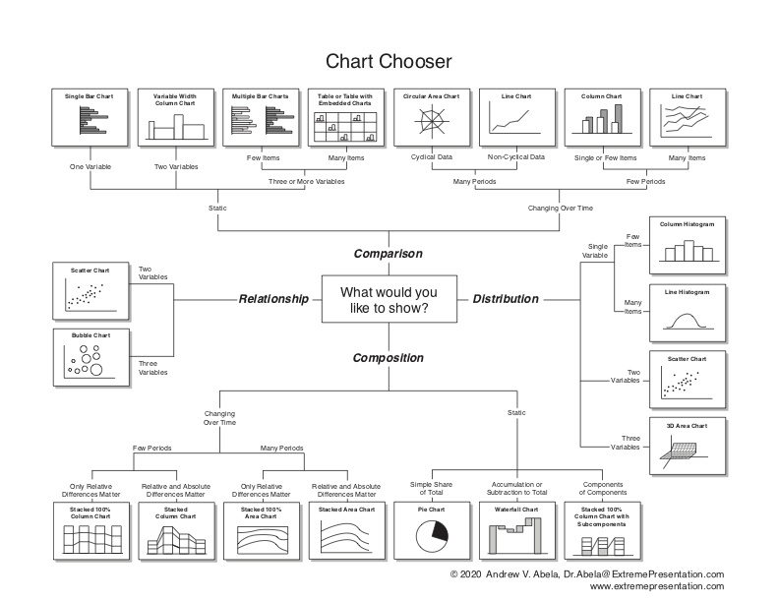
8
https://extremepresentation.typepad.com/.a/6a00d8341bfd2e53ef0263ec2ab026200c-pi

Slide 9
Visualization Theory
Graphic Feature Considerations
Gestalt Principles
Proximity
Elements which are close to one another are perceived as a group
Similarity
Elements which are similar in color, size, shape, or orientation are perceived as a group
Enclosure
Elements which are enclosed and seem to have a boundary are perceived as part of a group
Closure
The eye tends to naturally enclose shapes
Continuity
Elements that are aligned with one another are perceived as belonging together
Connection
Elements that are connected are perceived as being part of the same group
Types of Data
Quantitative
Precise, Numerical Values
Ordinal
Has a Meaningful Order
Nominal
Groups that are not ordere

Slide 10
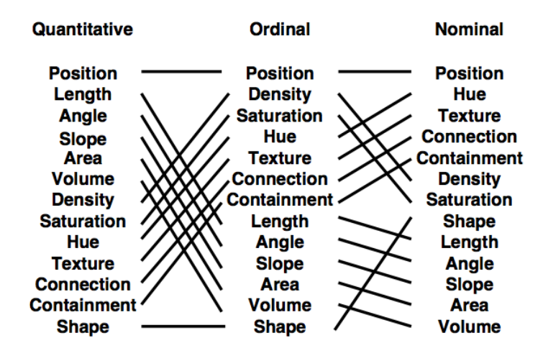
https://jonathansoma.com/lede/storytelling/classes/dealing-with-data/images/mackinley.png

Slide 11

Visualization Theory
Graphic Feature Considerations
These features should be considered closely when designing visualizations
More features means more information…
Also means more clutter
Simplifying visualizations can increase the audience’s ability to absorb information
Show Me the Numbers

Slide 12
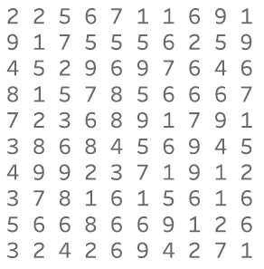
Visualization Theory
Graphic Feature Considerations
Highlighting key information draws the attention
How many 9’s are there in this graphic?
Show Me the Numbers

Slide 13
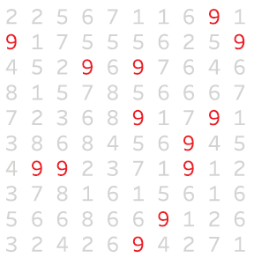
Visualization Theory
Graphic Feature Considerations
Highlighting key information draws the attention
How about this one?
Show Me the Numbers

Slide 14
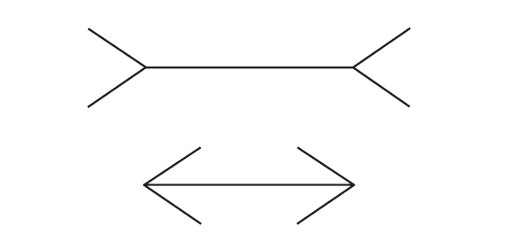
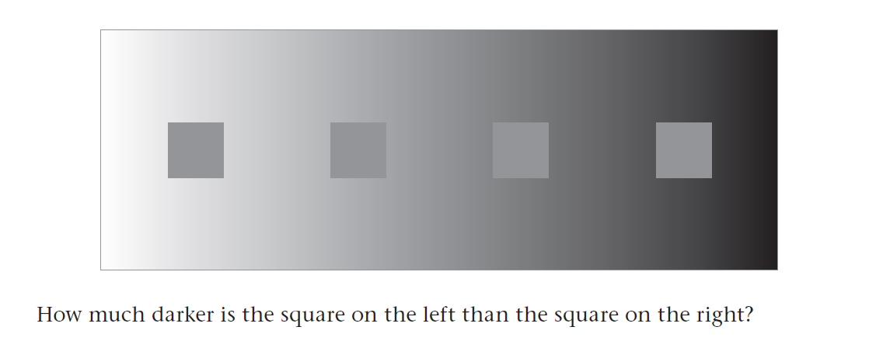
Visualization Theory
Graphic Feature Considerations
The principles can also deceive if used incorrectly
Show Me the Numbers

Slide 15
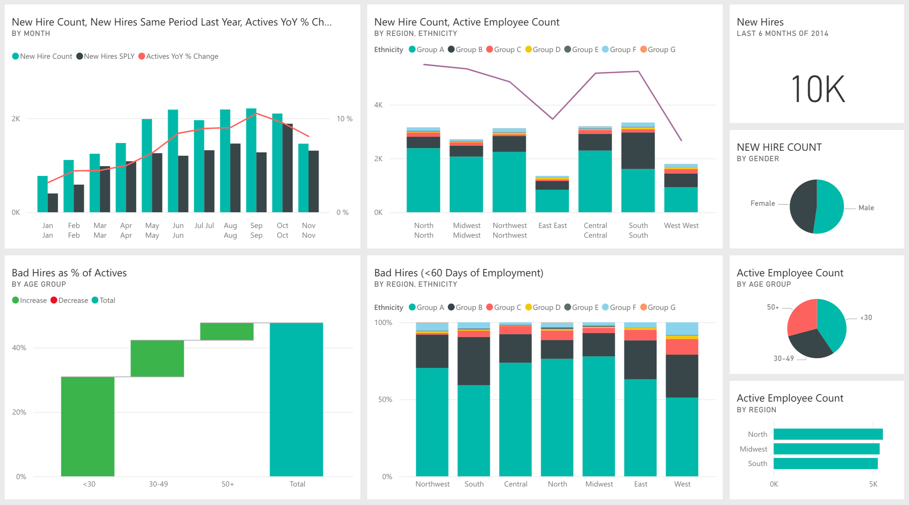
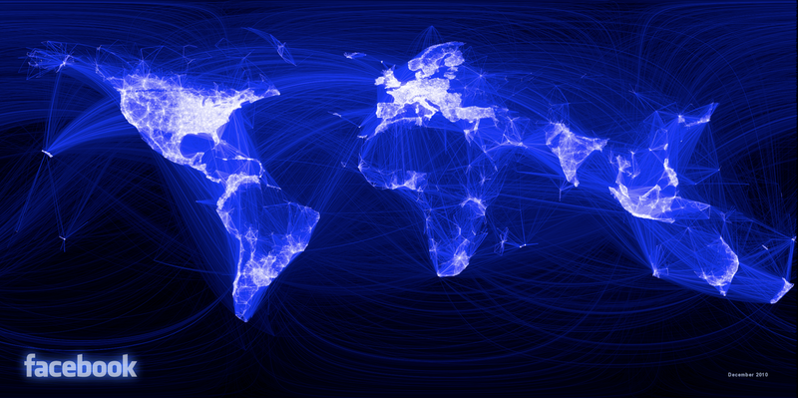
Considerations
Visualization Considerations
Your audience
Question you are answering
Color schemes
https://colorbrewer2.org/
https://coolors.co/generate
Missing values
Things to Avoid
Pie Charts
Clutter
Deceptive Visualizations
https://docs.appspace.com/wp-content/uploads/2021/06/Power-BI-Card.png
https://revolution-computing.typepad.com/.a/6a010534b1db25970b0147e0ae51b2970b-800wi

Slide 16
Eda walkthrough
EDA on Titanic Dataset
Multiple visualization types
Data cleaning, manipulation

Slide 17
Group breakouts
Work in groups of 3-4
Must include techs and scholars
SSG Malagon has designated teams
Each individual must make a visualization using the secondary dataset
Present your visualizations to your group
Provide feedback, why did you choose the features, graph type, colors, orientation
Choose your champion visualization to iterate on
Opportunity to come up and present your graphic to the Factory
Prompts to address in your EDA
Compare across a variable
Find a correlation with the predictive variable
Find a correlation between two independent variables
Groups should present the intermediate iteration and the final iteration of their chosen visualization
Be creative
https://www.kaggle.com/datasets/unsdsn/world-happiness

Slide 18
THANK YOU

